Slide 1
Learning objective: to use colours to talk about clothes.
Mercredi, 25 mars
Mon Uniforme

Slide 2
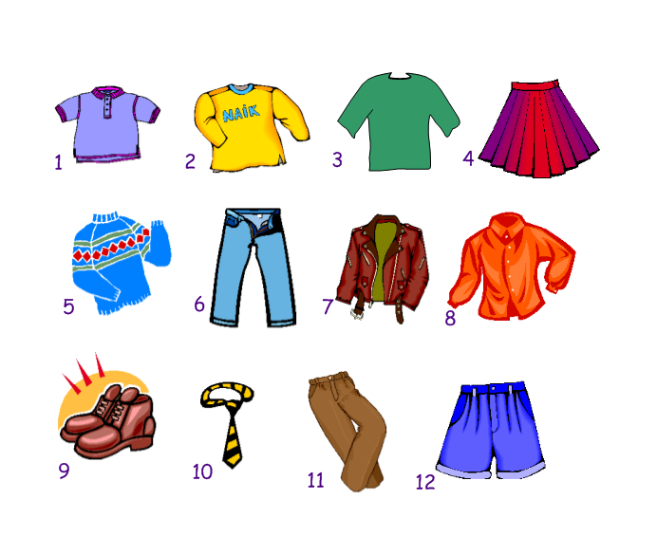
un polo
un sweat
un tee shirt
une jupe
un pullover
un jean
une veste
une chemise
des chaussures
une cravate
un pantalon
un short

Slide 3
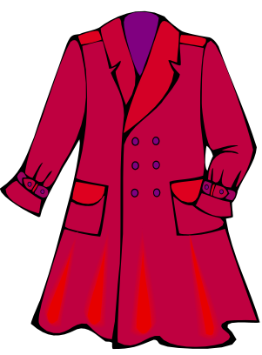
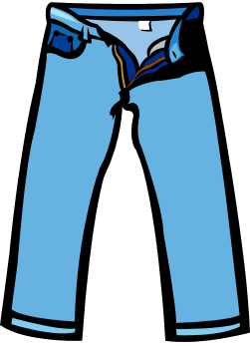
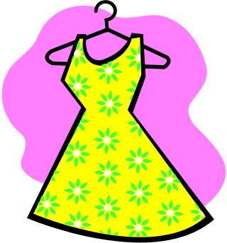
In English we use colours as adjectives before a noun eg:-
a yellow dress, a red coat, blue jeans
un manteau
une robe
jaune
rouge
un jean
bleu
In French we use colours as adjectives after a noun.
The endings of the adjectives change depending on whether the noun is masculine, feminine or plural.

Slide 4
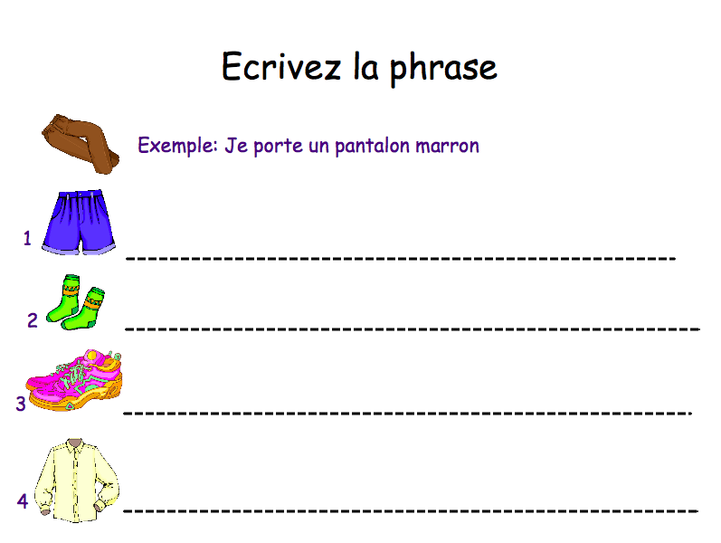
Tip! Use the table
from yesterday
to help you.
Je porte un short bleu.
Je porte des chaussettes vertes.
Je porte des baskets roses.
Je porte une chemise jaune.

Slide 5


il porte / elle porte
Draw the clothes on your worksheet showing what Antoine and Céline are wearing.
Then write 2 sentences to say what Stéphanie and Pierre are wearing before drawing their outfits.

Slide 6
La bataille navale!
You need to draw on your grid:
1 battleship (3 squares)
2 submarines (2 squares each)
1 cruiser (1 square)
Your partner says a phrase, e.g. 'Tu portes une robe jaune?' If 'une robe' and 'jaune' show a square that has your ship in it, that is a hit (say 'oui, je porte...').
If not, that is a miss (say 'non').
If your partner 'sinks' your ship, you have to say 'coulé'!
The first person to sink all of their partner's ships wins!

Slide 7
